Slide 1





School of Information Technology and Engineering
Group 6:
ID: 21B031189
CHALIYEV
ZHANDARBEK
ID: 21B030851
KULZHABAY
DAMIR
ID: 21B030850
KOLYBAEVA
ZARINA
ID: 21B030839
KAKHARMANOVA
ARUZHAN
ID: 21B030843
KARAZHAKOVA
GULBAKHRAM
Date of presentation: 25 October, 2023

Slide 2
RUNNING THE BUSINESS FROM THE PALM OF YOUR HAND

Slide 3
Running business on your palm
INTRODUCTION TO THE CASE
In today's rapidly changing business landscape, mobile devices are indispensable for companies. They enhance efficiency, enable innovative applications for data access, performance monitoring, and interactions with stakeholders.

Slide 4
Problems identified
in the case
Running business on your palm
Reliability and Connectivity
Mobile devices rely on network connections, which can be unreliable or slow in some areas. This can affect communication and access to critical business data.
Limited Functionality
Devices can have lack of functionality due to their screen size, battery capacity, or operational system incompatibilities
Security Concerns
While mobile devices have improved security features, they are still susceptible to data breaches, especially if not adequately protected.
Device Management
Managing a fleet of mobile devices can be complex. IT departments need to ensure all devices are up to date, secure, and have the necessary business apps and configurations
Regulatory Compliance
It is important to ensure that the use of handheld devices aligns with relevant data protection and privacy regulations.

Slide 5
Case study questions
Running business on your palm
01
03
02
04
How do the applications improve operational efficiency and decision making?
Which businesses benefit from equipping employees with mobile devices?
What problems did business solve with mobile digital devices in this case study?
What does the statement "The iPhone is not a game changer, it's an industry changer" imply for customer and supplier interactions?

Slide 6
Running business on your palm
How do the applications improve operational efficiency and decision making?
01
Mobile SalesPro
Transformer Monitoring app
The Roambi Visualizer app
Dow Corning’s Analytics App

Slide 7
What problems did business solve with mobile digital devices in this case study?
Running business on your palm
REMOTE MANAGEMENT
QUALITY CONTROL
GLOBAL CONNECTIVITY
02
ability to manage and communicate with the business remotely
ensuring the accuracy and efficiency of the production process
ability to monitor and manage global operations with real-time data

Slide 8
Running business on your palm
Which businesses benefit from equipping employees with mobile devices?
03
Sunbelt Rentals
Jackson Kayak
Dow Corning
General Electric (GE)

Slide 9
Running business on your palm
What does the statement "The iPhone is not a game changer, it's an industry changer" imply for customer and supplier interactions?
04
increased customer engagement
improved customer service
enhanced supplier relationships

Slide 10
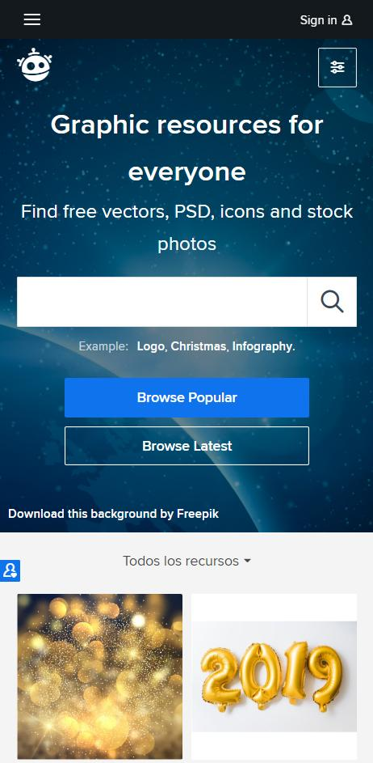
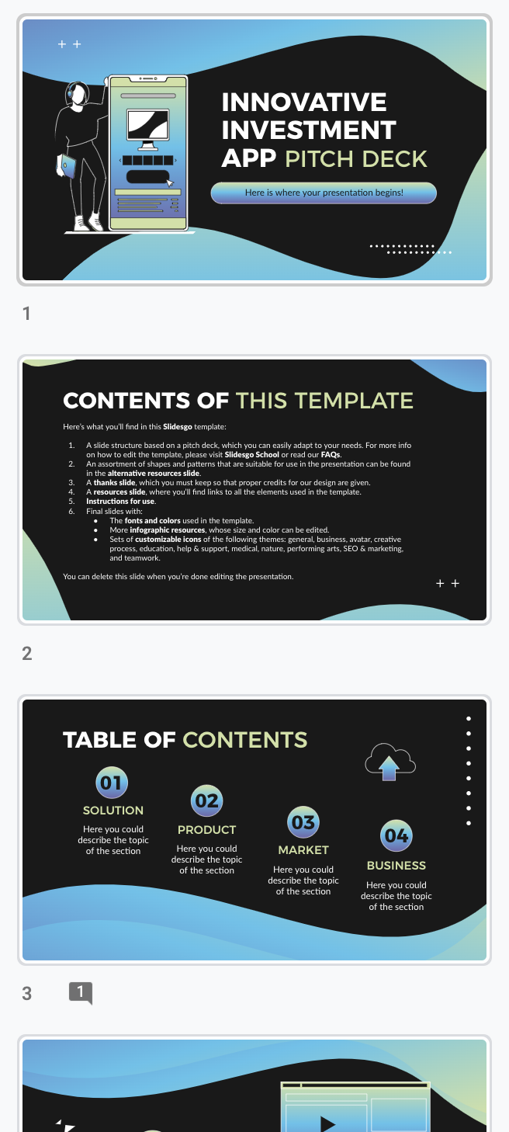
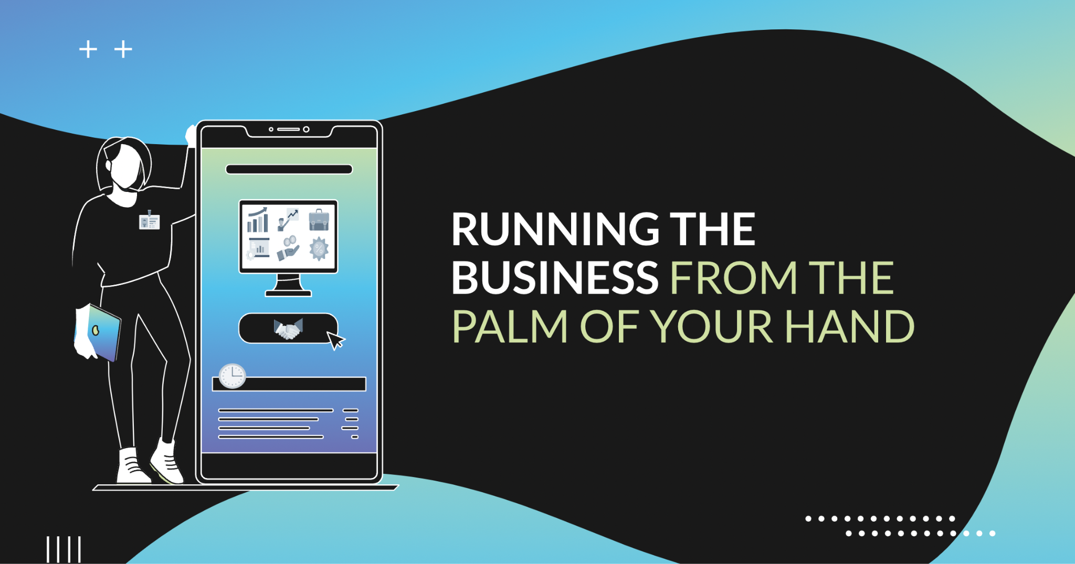
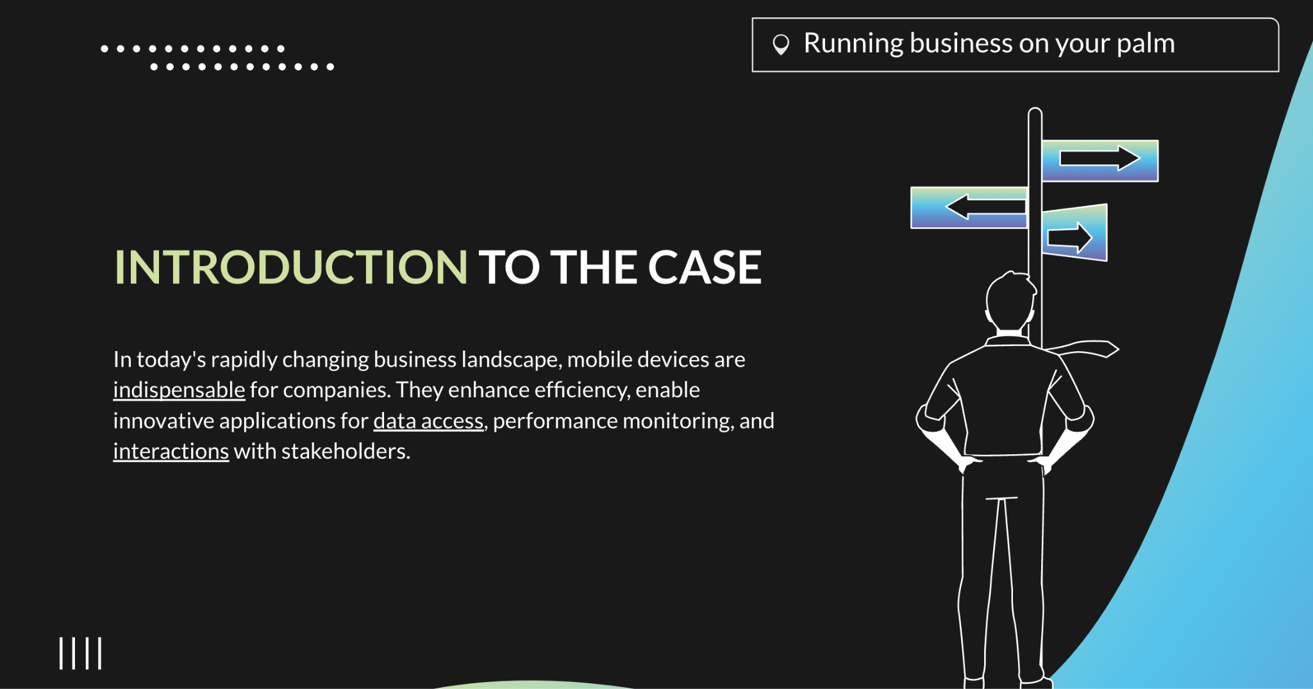
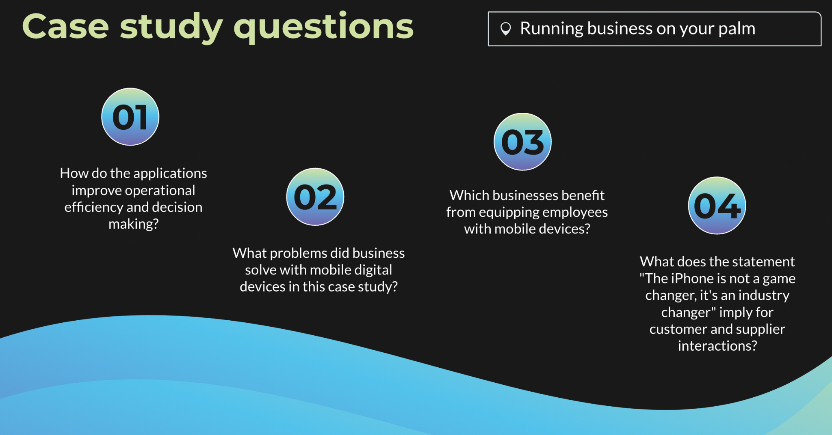
CONCLUSION
The strategic adoption of mobile devices can lead to significant competitive advantages and improved decision-making
NEPTUNE
Neptune is the eighth planet.
BUSINESS ENVIRONMENT
Contributes to the success and
growth of the companies

Slide 11
LEARNINGS
Mobile Devices Revolutionize Business
Industry-Changing Implications
Global Accessibility
1
3
5
2
4
Custom Apps Address Common Problems
Operational Efficiency and Decision-Making

Slide 12
REFERENCES
1. Kenneth L., Jane L., 2014, "Management Information Systems. Managing the Digital Firm", 13th Edition. [Accessed 19 October, 2023]
2. Steve J., 2017, "Case Study: Running the Business from the Palm of Your Hand"
[online] Available at <https://www.coursebb.com/2017/01/25/case-study-running-business-palm-hand/>
[Accessed 21 October, 2023]
3. “Apple IPhone in Business” and “Apple iPad in Business"
Available at < www.apple.com> [Accessed October 19, 2023]
4. Erik Eckel, “What the IPhone 5 Will Offer Business Users” TechRepublic,
[Accessed 21 October, 2023]
5. Doug Henschen, “Mobilizing Enterprise Apps: The Next Big Leap,” Information Week, [Accessed 21 October, 2023]
6. "Interactive Session: Running the Business from the Palm", 2022, Available at <https://phdessay.com/interactive-session-organizations-running-the-business-from-the-palm-of-your-hand/>

Slide 13
THANK YOU FOR
ATTENTION!

